Slide 1
Project Title
AI Agents in Tic-Tac-Toe Tournament

Slide 2
Team Members
Amjad Ali・Surya Manjri
Introduction to Artificial Intelligence
Project

Slide 3

Objectives
Design Minimax, Minimax using Alpha beta pruning (refined) and Expectimax algorithm agents to solve the Tic-Tac-Toe game.
Play the Tic-Tac-Toe with the designed model
Human = -1 and Computer = +1.
Board starts with a 3x3 dimensional matrix of all Ơ’s.
Tic-Tac-Toe game logic depends on:
Heuristic Functions
Random Agents
Algorithms
Performance Metrics - Execution time, number of nodes explored.

Slide 4
Heuristic Functions
1. Evaluate function
2. Wins function
3. Game Over
4. Empty cells
5. Valid Move
6. Set Move
7. Clean
8. Render
9. Human vs AI turn
10. Reset Board
11. Play game

Slide 5
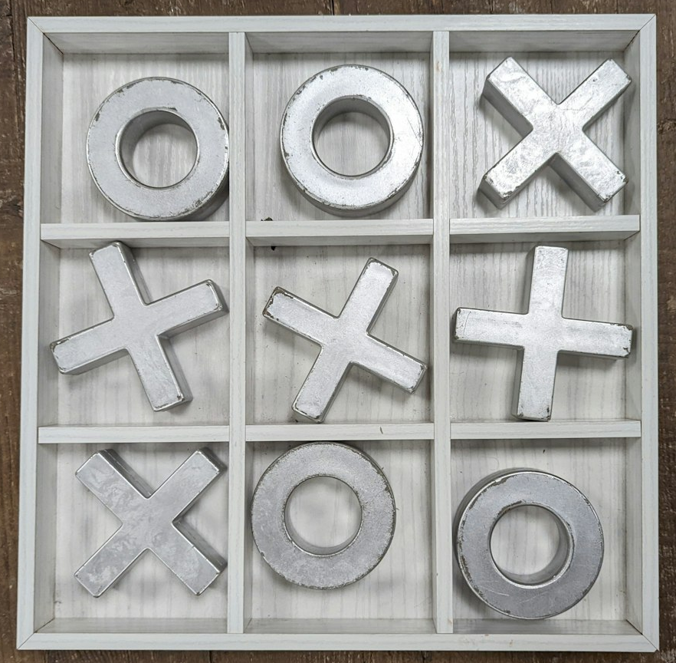
Approach (Tools & Techniques)
Core Components:
Tic-Tac-Toe Game Logic: This encompasses functions responsible for move validation, placement, and win/tie checking within the game. AI Agents:
Random Agent: This agent selects random empty spaces as its moves during gameplay – Human: -1 and Computer: +1
Algorithms: Utilizing the Minimax search algorithm along with alpha-beta pruning, and expectimax algorithm agent seeks to determine the optimal move.
Heuristic Agent: This agent evaluates potential moves based on a custom heuristic function, enhancing its decision-making process.
Tournament Framework:
The framework manages individual games between agents and orchestrates a round-robin tournament structure.
In this structure, each agent competes against every other agent multiple times. Additionally, it tracks the wins, losses, and ties for each agent throughout the tournament.

Slide 6

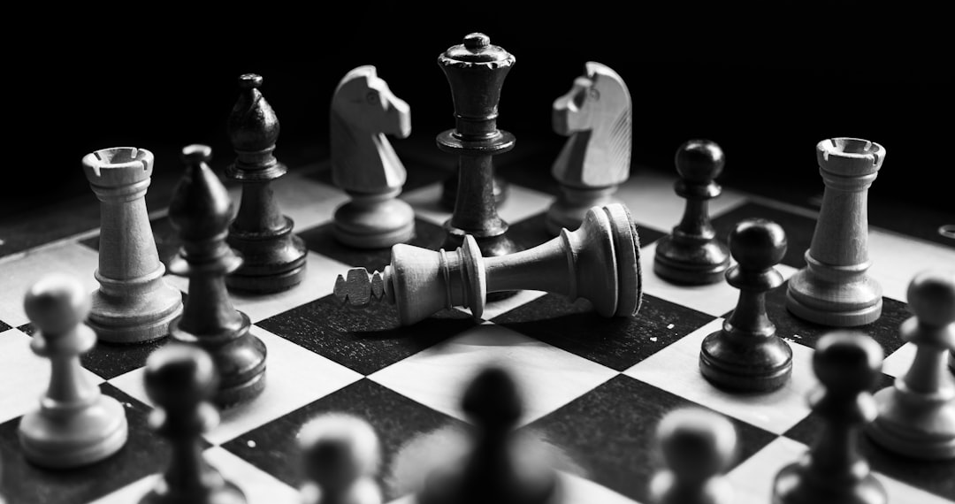
Deliverables
Functional Python Code
Reports & Video Explanation:
Implements core game logic, AI agents, and tournament framework.
A summary showing performance metrics for each agent.
A detailed report, along with the code, uploaded on Team GitHub Account.
Video Explanation uploaded on YouTube.

Slide 7
Evaluation Methodology
Flawless Execution:
Tournament Dominance:
Does the core Tic-Tac-Toe engine function flawlessly?
Are moves valid?
Can it correctly detect wins, losses, and ties?
Does each AI agent make decisions as expected?
Does the Random Agent truly play randomly?
Does the Minimax Agent leverage alpha-beta pruning?
Win Rate: Checking various patterns to check if the Human or AI agent v=wins.
Performance metrics – Number of nodes explored, time taken for each algorithm, good heuristics to maintain the rules of the game.

Slide 8
Thank You

